Slide 1
Chapter 1 Introduction to RF and Wireless Technology
1.1 A Wireless World
1.2 RF Design is Challenging
1.3 The Big Picture
Behzad Razavi, RF Microelectronics.
Prepared by Bo Wen, UCLA

Slide 2
Chapter Outline
A Wireless World
RF Design Challenges
Big Picture of
RF System
Wireless Communication
in Life
Trend in RF Development
Multitude of Disciplines
RF Trade-offs
Demand for cost and performance
TX and RX

Slide 3
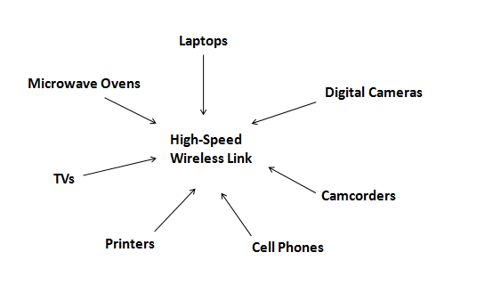
A Wireless World
High-speed wireless links (WiFi, Bluetooth) allow seamless connections among device and appliance.

Slide 4
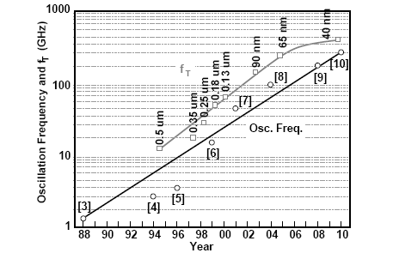
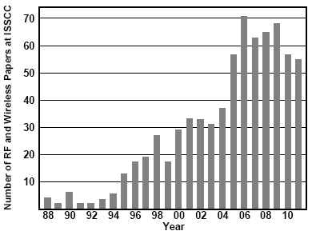
Explosive Growth of Wireless Communication
The affordability of low cost and multiple functions finds its roots in Integration
Performance of RF circuits has also improved.

Slide 5
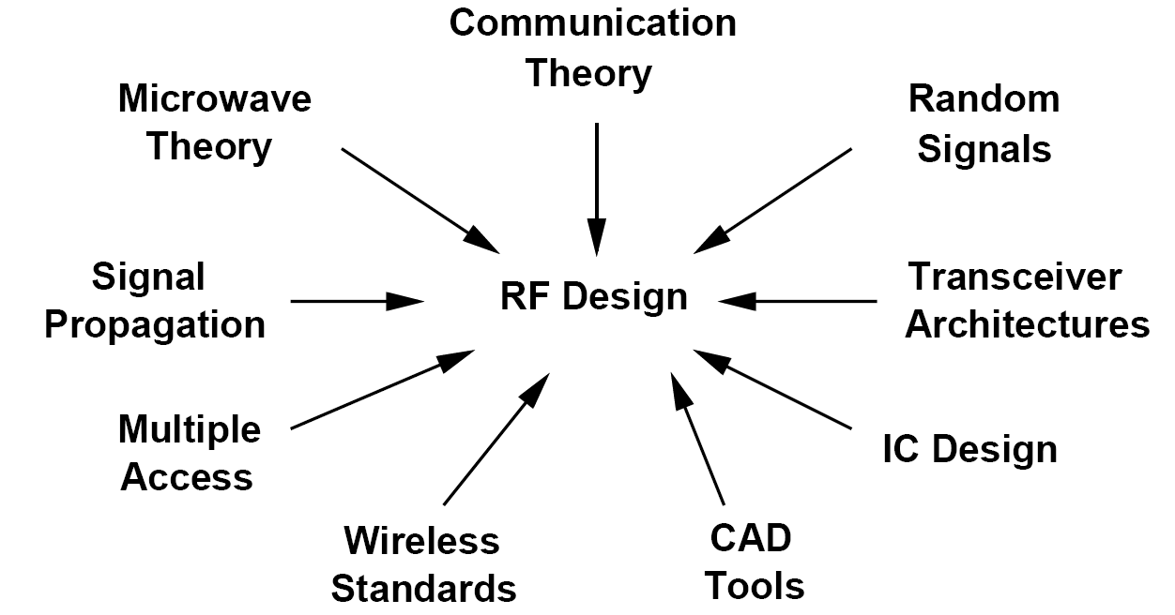
RF Design is Challenging: Multi-discipline
RF design draws upon a multitude of disciplines.

Slide 6
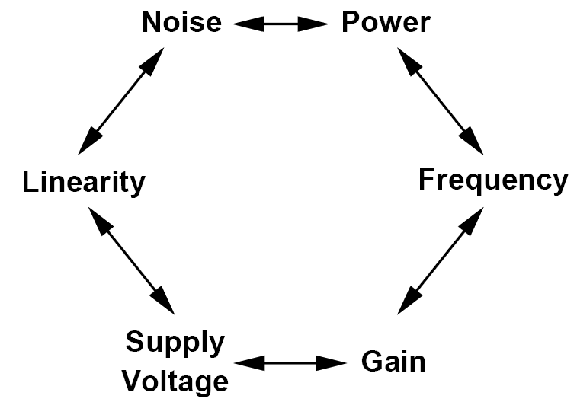
RF Design is Challenging: Trade-offs
RF circuits and transceivers must deal with numerous trade-offs.
Demand for higher performance, lower cost and greater functionality

Slide 7
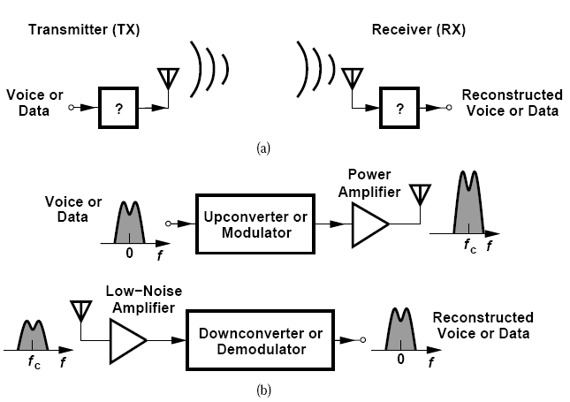
The Big Picture: RF Communication
TX: Drive antenna with
high power level
RX: Sense small signal
(amplify with low noise)

Slide 8
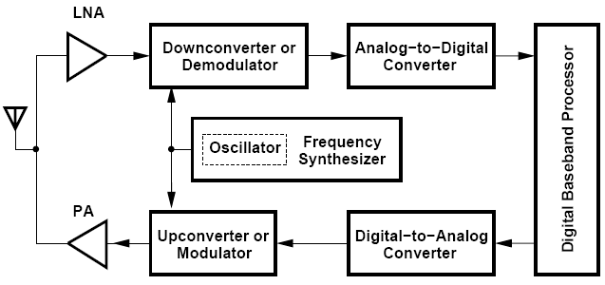
The Big Picture: Generic RF Transceiver
Signals are upconverted/downconverted at TX/RX, by an oscillator controlled by a Frequency Synthesizer

Slide 9
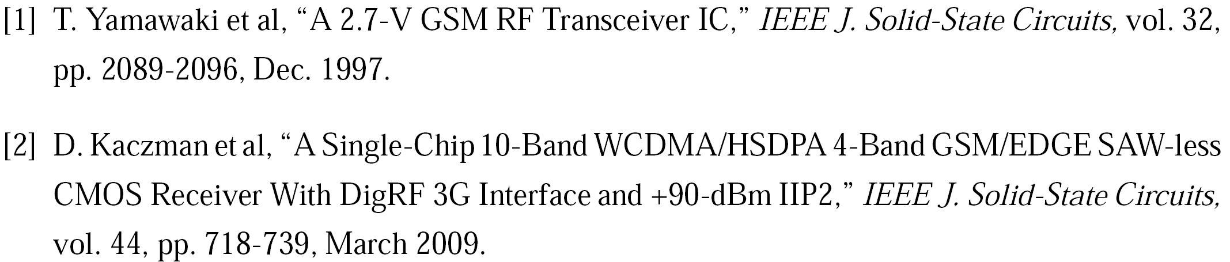
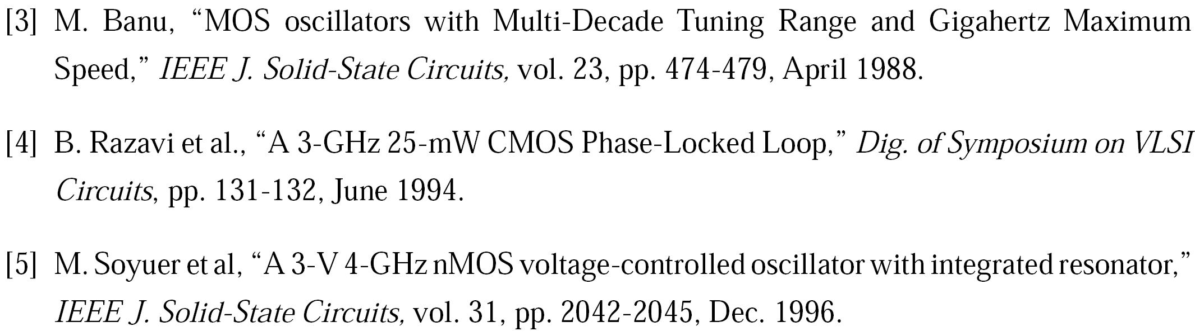
References (Ⅰ)

Slide 10
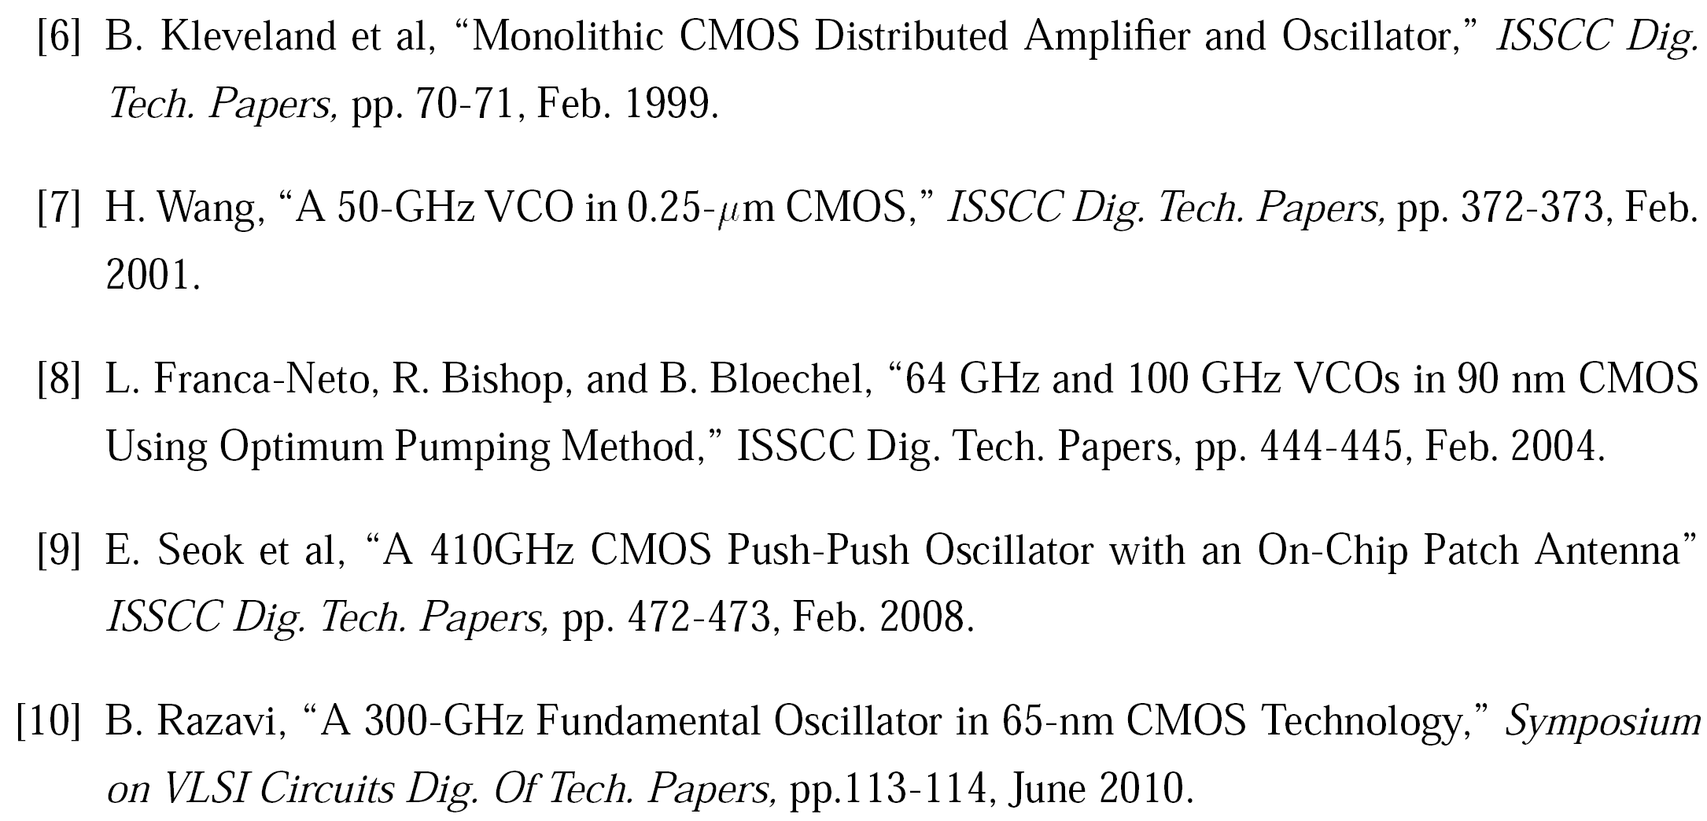
References (Ⅱ)

